Slide 1
Use Case Diagrams

Slide 2
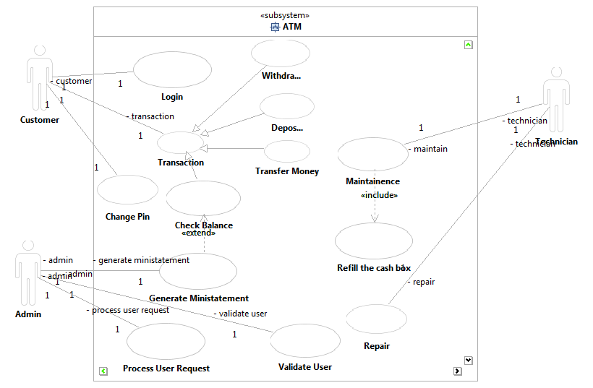
ATM

Slide 3
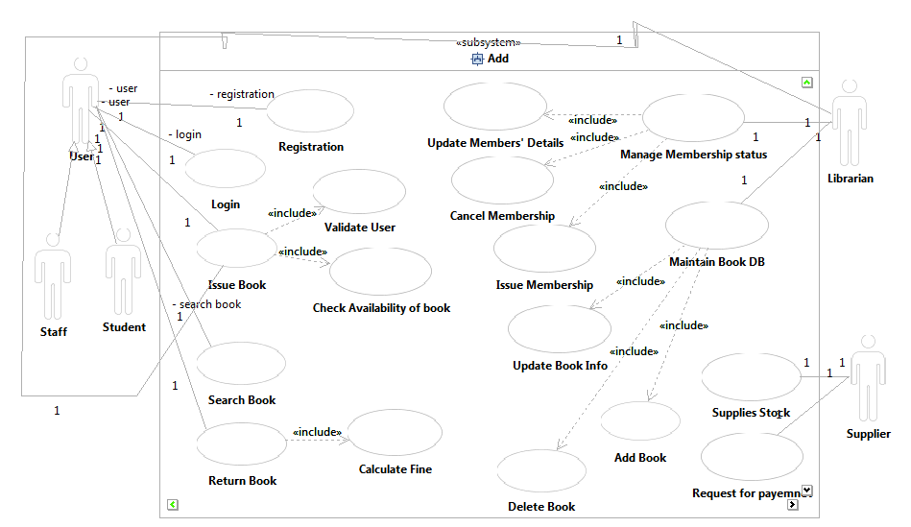
LMS

Slide 4
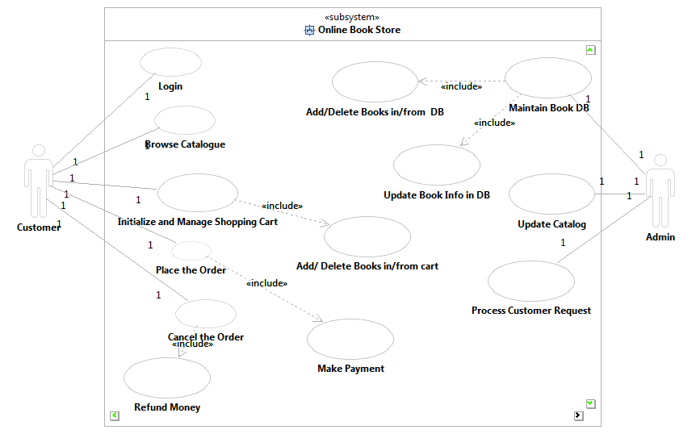
Online Book Store

Slide 5
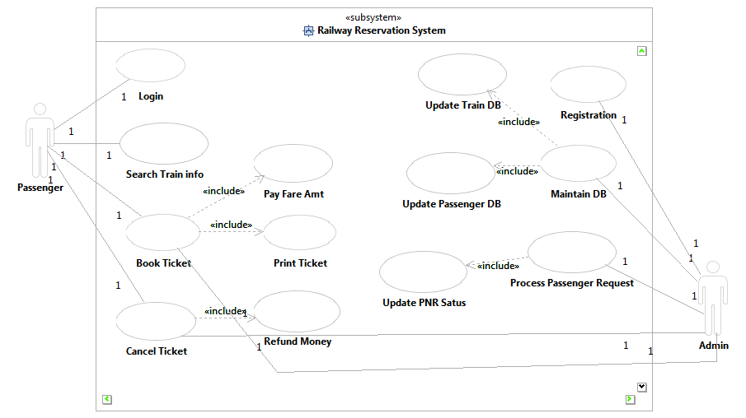
Railway Reservation Syatem

Slide 6
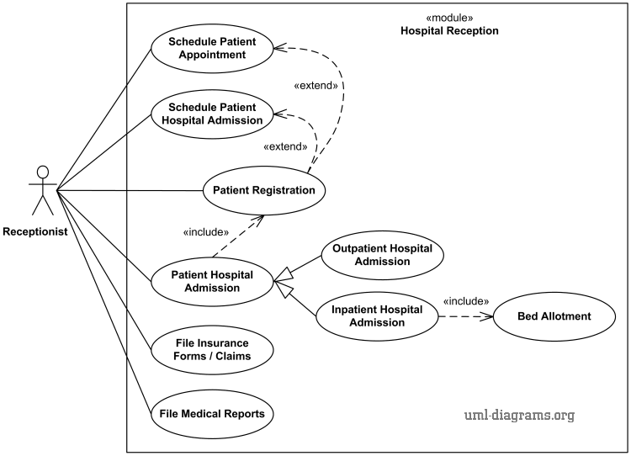
Hospital Mangement System

